Slide 1

Customer Spending Behavior Classification using Online Shopping Data: A KDD Approach-PART-A Department of Computer Science and Engineering Seshadri Rao Gudlavalleru Engineering College, Gudlavalleru. Under the Guidance of Dr. M. Babu Rao, M .Tech, Ph.D., Head of the Department
BOLLU SNIGDHA (22481A0535) DONGARA YASWANTH (22481A0553) GARIKIPATI TRIPURA (22481A0558) GOLI PRABHAS (22481A0560)

Slide 2
ABSTRACT
Analyzing customer purchasing behavior is crucial for improving marketing strategies, product recommendations, and sales optimization. Manual analysis of vast online shopping data is inefficient and inaccurate. This project leverages data mining techniques using the Orange tool to classify customers, identify shopping patterns, and predict trends. The insights will help businesses enhance personalization, inventory management, and targeted marketing, ensuring better decision-making and customer engagement.

Slide 3
REQUIREMENTS
Hardware Requirements:
Processor: Intel i7 or higher (recommended: i5/i7 for faster performance)
RAM: Minimum 4 GB (recommended: 8 GB or higher for handling larger datasets)
Hard Disk: At least 1 GB of free space for Orange and dataset storage
Display:Minimum 1024x768 resolution
Operating System: Windows 10 or higher / macOS / Linux (64-bit)
Software Requirements:
Orange Data Mining Tool:isual data analysis and modeling (version 3.x recommended)
Microsoft SSMS:Managing and querying relational databases (SQL Server)
MicrosoftVisualStudio:Development and integration environment for coding
Microsoft Excel / CSV Tool:For dataset formatting and conversion

Slide 4
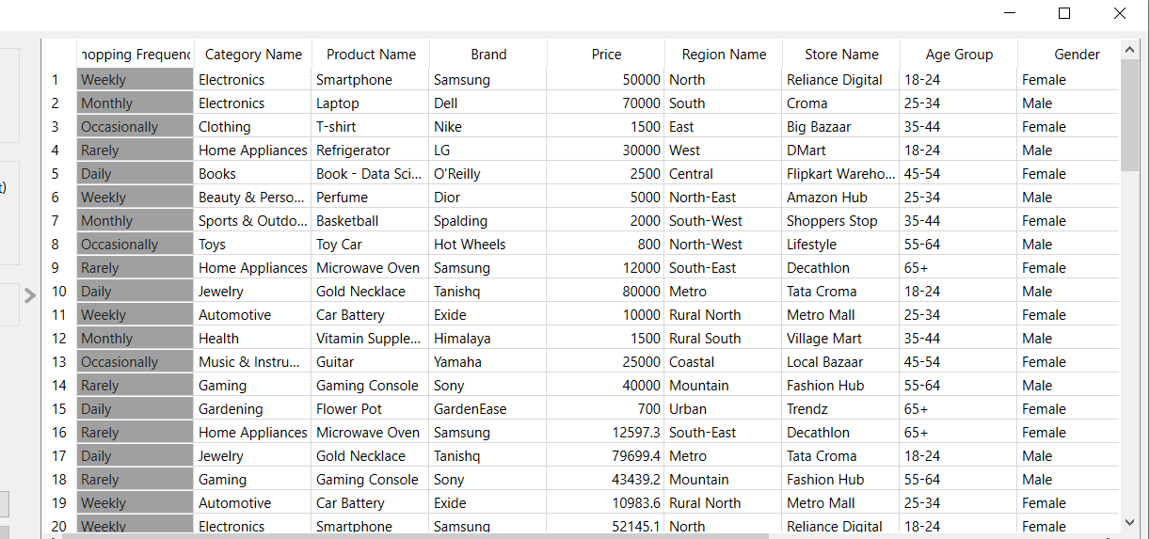
Dataset
Dataset is collected Using Google Forms
Google form link- Online Shopping Preferences & Experience

Slide 5
Fields taken in our dataset
Shopping frequency
Category name
Product name
Brand
Price
Region name
Store name
Age group
Gender
Purchase date
Total spending
Order quantity
Order cost

Slide 6
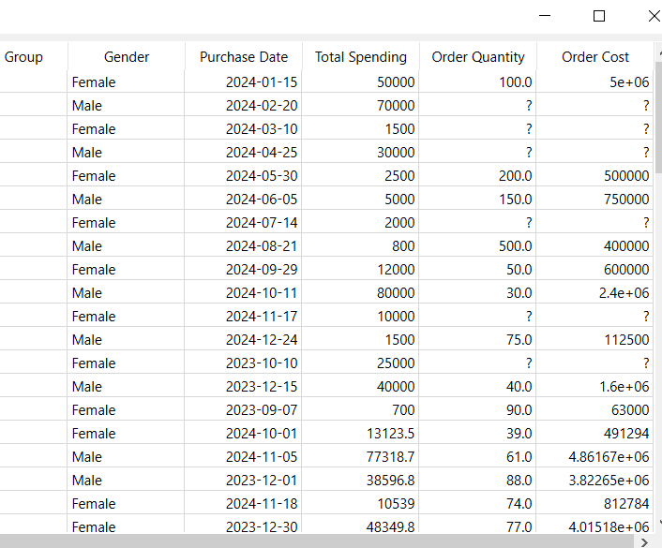
Preprocessing of dataset
Preprocess the Dataset Using Orange Tool,My dataset has missing values
Before imputing

Slide 7
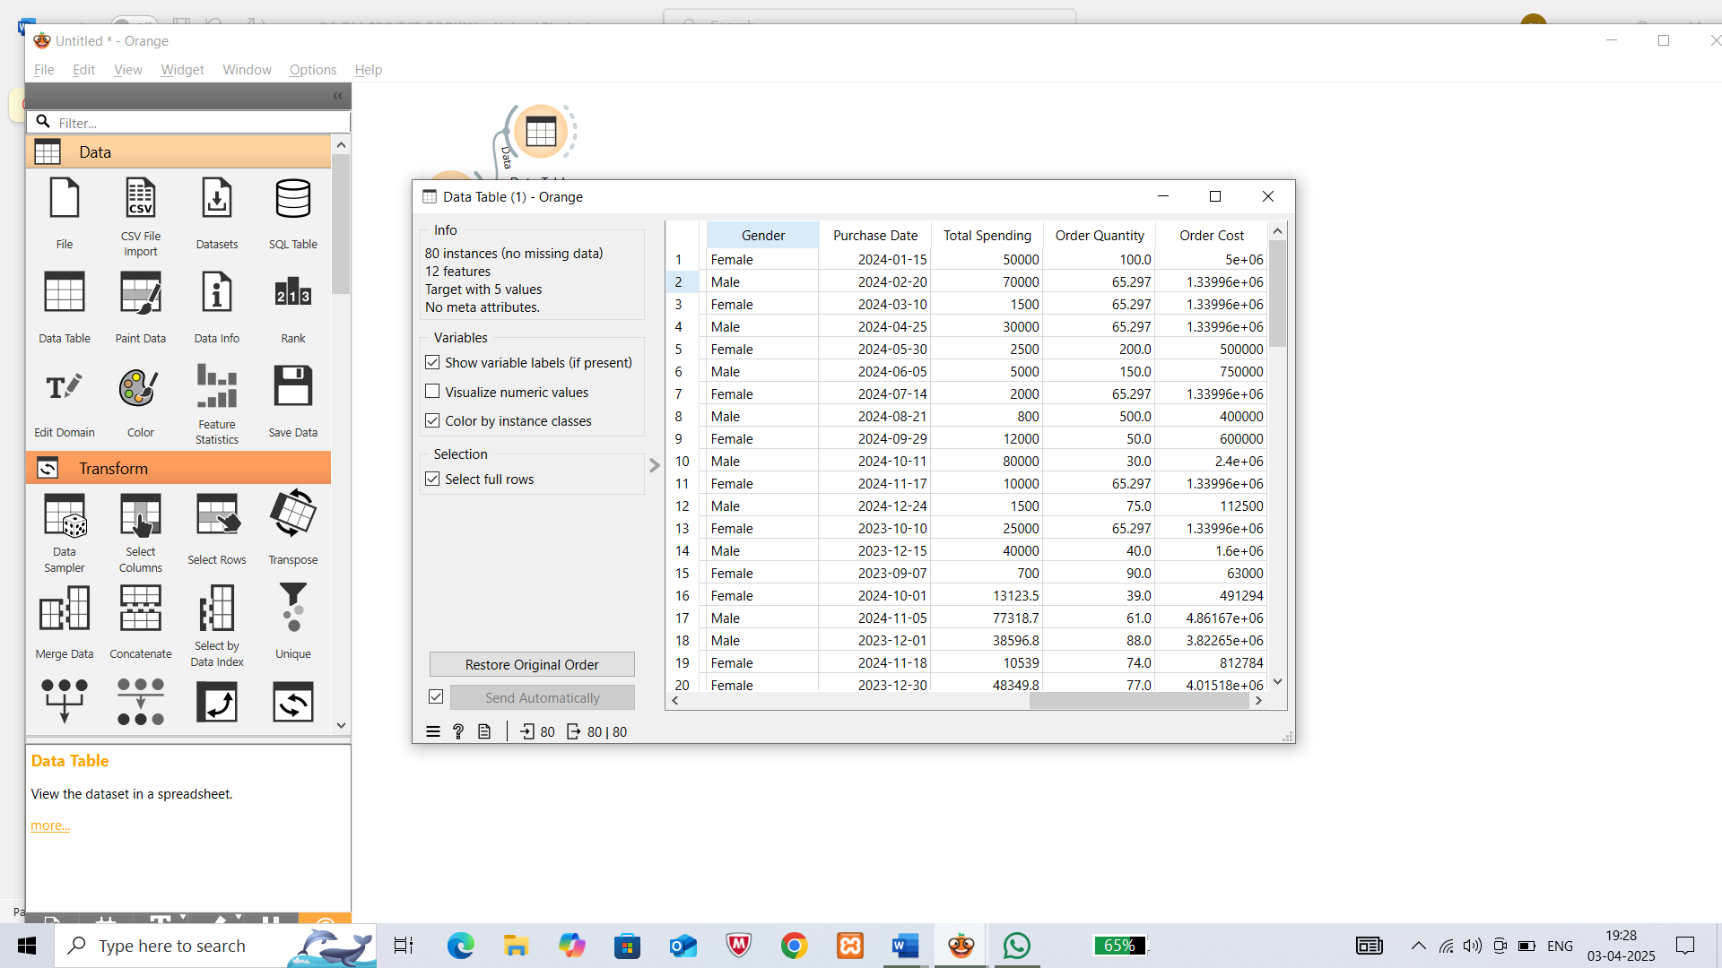
After imputing

Slide 8
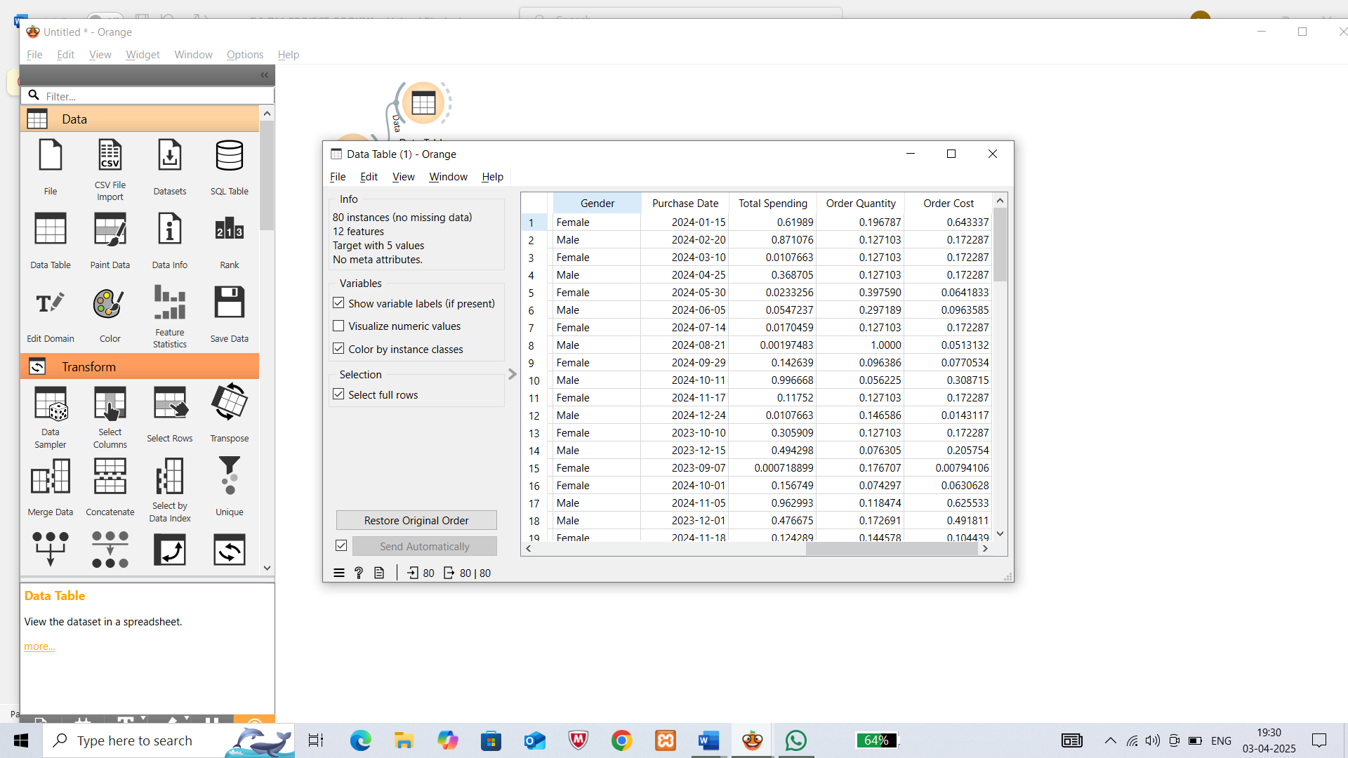
Normalized the numerical values using Normalization[0,1]
After normalization

Slide 9
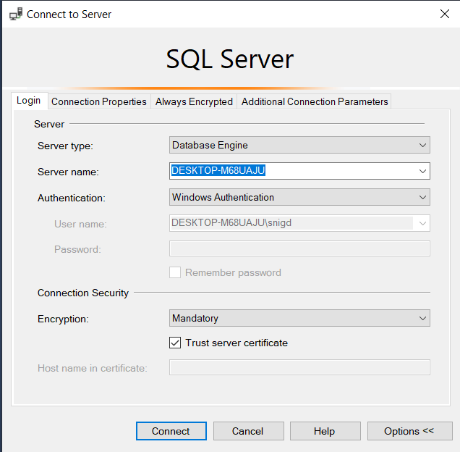
Schema Creation using SQL(SSMS)….
Used SQL Server Management Studio(SSMS)
- Designed tables for fact and dimension tables
Key Actions Performed:
- Wrote SQL queries to create schemas
- Inserted preprocessed data into tables
- Created relationships between tables using foreign keys
- Created star, snowflake and fact Constellatiom Schemas
- Used SQL Server for schema creation and data insertion
- Visualized schemas in Visual Studio (cubes and Relationships)
Schema Types Implemented:
- Star schema
- Snow flake schema
- Fact constellation schema

Slide 10
Star schema
I have created 4 dimension tables and 1 fact table
The four dimension tables with attributes and fact table with attributes are below
Dimension tables :
1)Product – product_id , product_name , category_id , brand , price
2)Store – store_id , store_name , region_id
3)Customer – cust_id , age_group , gender , shopping_frequency
4) Time – time_id , purchase_date , month , quarter , year
Fact table :
1)Salesfact – sales_id , cust_id , product_id , time_id , store_id , total_spending,salesfact _count

Slide 11
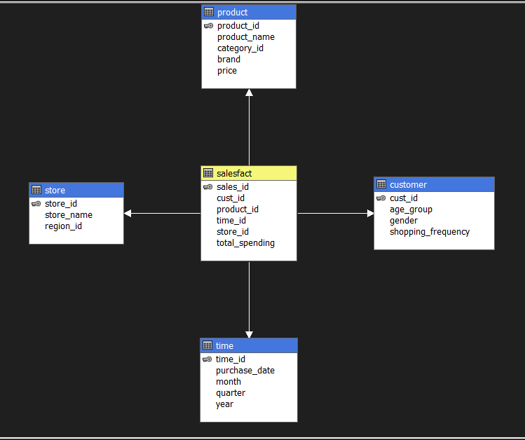
STAR SCHEMA

Slide 12
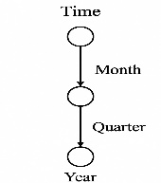
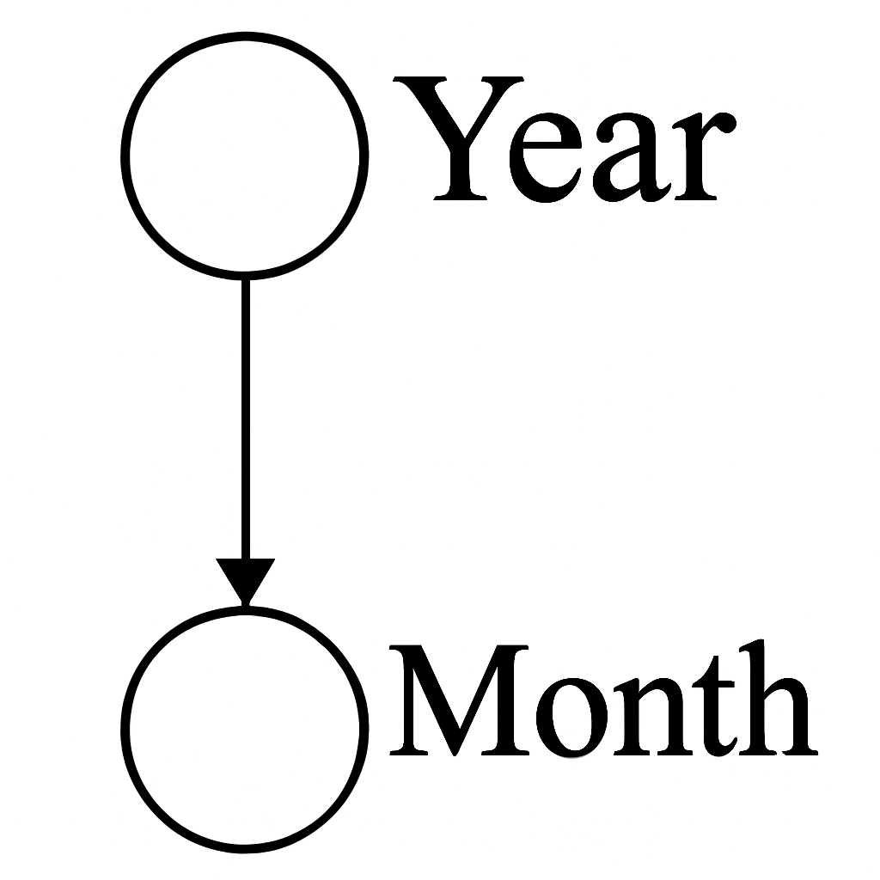
Concept Hierarchies used in star schema
Roll up Drill down

Slide 13
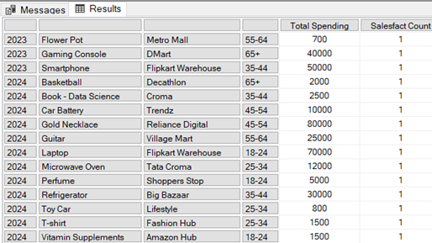
STAR SCHEMA-OLAP OPERATIONS
Roll-up :
(A) What is the total spending and sales count for each combination of year, product, store, and customer age group?
SELECT
{[Measures].[Total Spending], [Measures].[Salesfact Count]} ON COLUMNS,
NON EMPTY
CROSSJOIN(
[Time].[Year].Children,
CROSSJOIN(
[Product].[Product Name].Children,
CROSSJOIN(
[Store].[Store Name].Children,
[Customer].[Age Group].Children
) ) ) ON ROWS
Execution Time: 4 ms

Slide 14
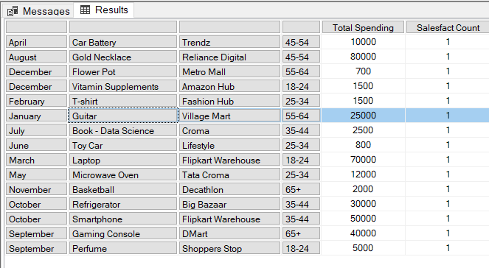
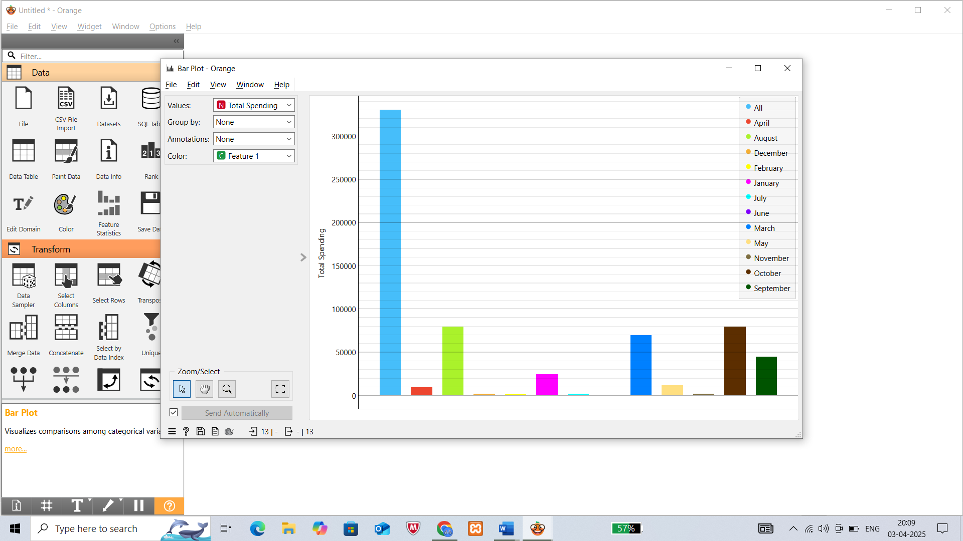
Drill-Down
(B) ) What is the total spending and sales count for each combination of month, product, store, and customer age group?
SELECT
{[Measures].[Total Spending], [Measures].[Salesfact Count]} ON COLUMNS,
NON EMPTY
CROSSJOIN(
[Time].[Month].Children,
CROSSJOIN(
[Product].[Product Name].Children,
CROSSJOIN(
[Store].[Store Name].Children,
[Customer].[Age Group].Children
) ) ) ON ROWS
FROM [star schema]]
Execution Time: 10 ms

Slide 15
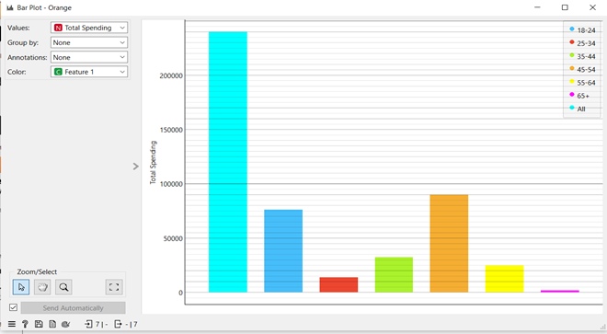
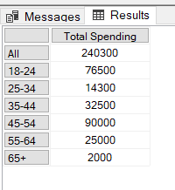
Slice: Slice for year = “2024”
(C) What is the total spending for the year 2024?
SELECT
{[Measures].[Total Spending]} ON COLUMNS,
NONEMPTY(
[Customer].[Age Group].MEMBER) ON ROWS
FROM [star schema]
WHERE ([Time].[Year].[2024])
Execution Time: 4 ms

Slide 16
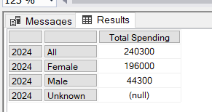
Dice: Dice for (Time.Year=”2024”) and (Customer=”Gender” ) and (Measures= “Total Spending”)
(D) What is the total spending for customers aged 25-34 in 2024?
SELECT
{[Measures].[Total Spending]} ON COLUMNS,
{[Time].[Year].[2024]} * [Customer].[Gender].MEMBERS ON ROWS
FROM [star schema]
Execution Time: 4 ms

Slide 17
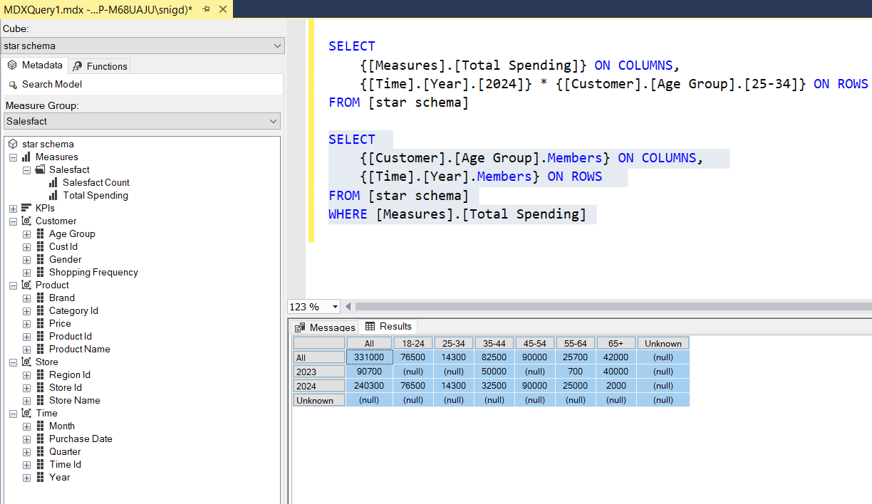
Pivot:
(E) What is the total spending across different age groups?
SELECT
{[Customer].[Age Group].Members} ON COLUMNS,
{[Time].[Year].Members} ON ROWS
FROM [star schema]
WHERE [Measures].[Total Spending]

Slide 18
Snow flake schema
I have created 4 dimension tables and 2 extended tables and 1 fact table
The four dimension tables with attributes and fact table with attributes are below
Dimension tables :
1)Product – product_id , product_name , category_id , brand , price
2)Store – store_id, store_name , region_id
3)Customer – cust_id , age_group, gender , shopping_frequency
4) Time – time_id , purchase_date , month , quarter , year
Extended tables :
1)Region – region_id , region_name
2)Product_category – category_id , category_name
Fact table :
1)Salesfact – sales_id , cust_id , product_id , time_id , store_id , total_spending,salesfact count

Slide 19
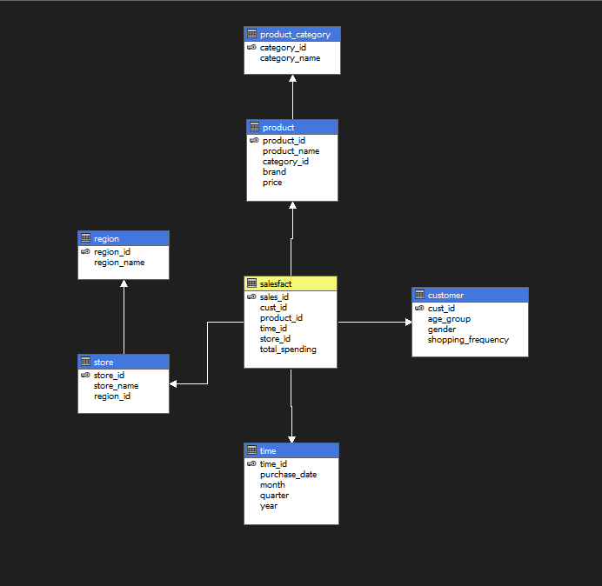
Snow flake schema

Slide 20
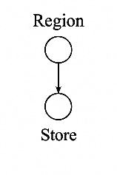
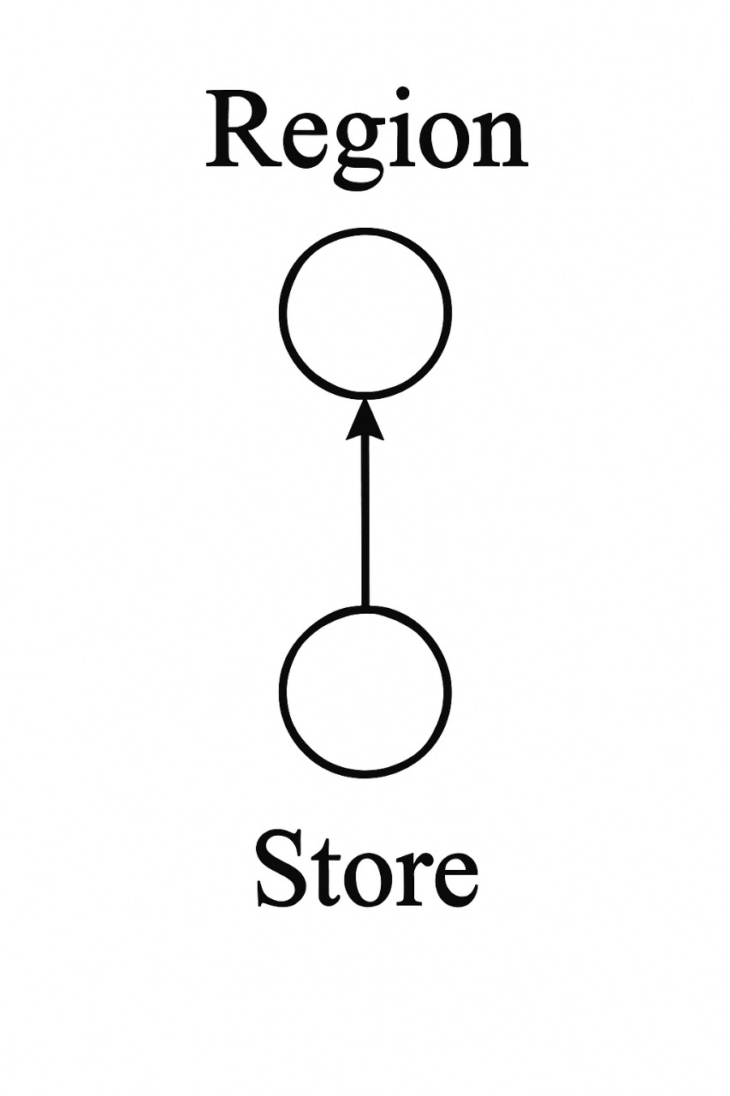
Concept Hierarchy used in snow flake schema
Roll up Drill down

Slide 21
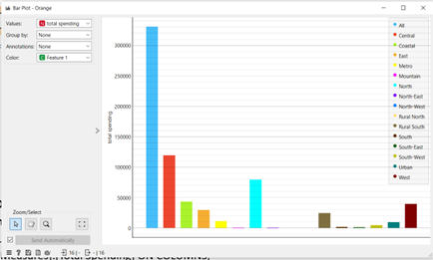
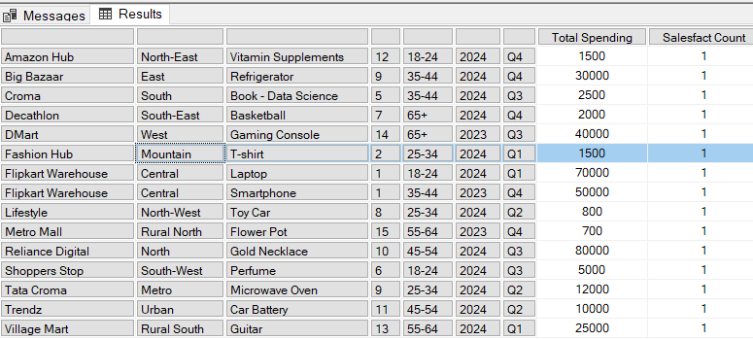
SNOW FLAKE SCHEMA-OLAP OPERATIONS
Roll-up:
(A) What is the total spending and sales count grouped by store name, region name, product name, category ID, customer age group, year, and quarter?SELECT
{[Measures].[Total Spending], [Measures].[salesfact count]} ON COLUMNS,
NON EMPTY
CROSSJOIN([Store].[Store Name].[Store Name].Members,
CROSSJOIN( [Store].[Region Name].[Region Name].Members,
CROSSJOIN( [Product].[Product Name].[Product Name].Members,
CROSSJOIN{ [Product].[Category ID].[Category ID].Members,
CROSSJOIN( [Customer].[Age Group].[Age Group].Members,
CROSSJOIN([Time].[Year].[Year].Members,
[Time].[Quarter].[Quarter].Members
) ) ) ) ) ) ON ROWS
FROM [snow flake schema]
Execution Time: 3 ms

Slide 22
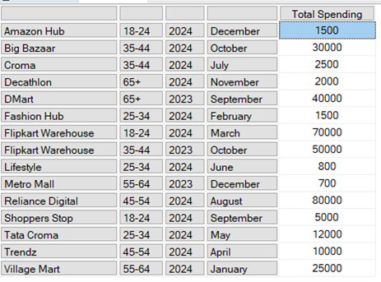
Drill Down
What is the total spending store name, customer age group, year, and quarter??
SELECT
[Measures].[Total Spending] ON COLUMNS,
NON EMPTY
CROSSJOIN(
[Store].[Store Name].[Store Name].Members,
CROSSJOIN(
[Customer].[Age Group].[Age Group].Members,
CROSSJOIN( [Time].[Year].[Year].Members,
[Time].[Month].[Month].Members
) ) ) ON ROWS
FROM [snow flake schema]
Execution Time: 5 ms

Slide 23
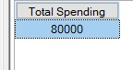
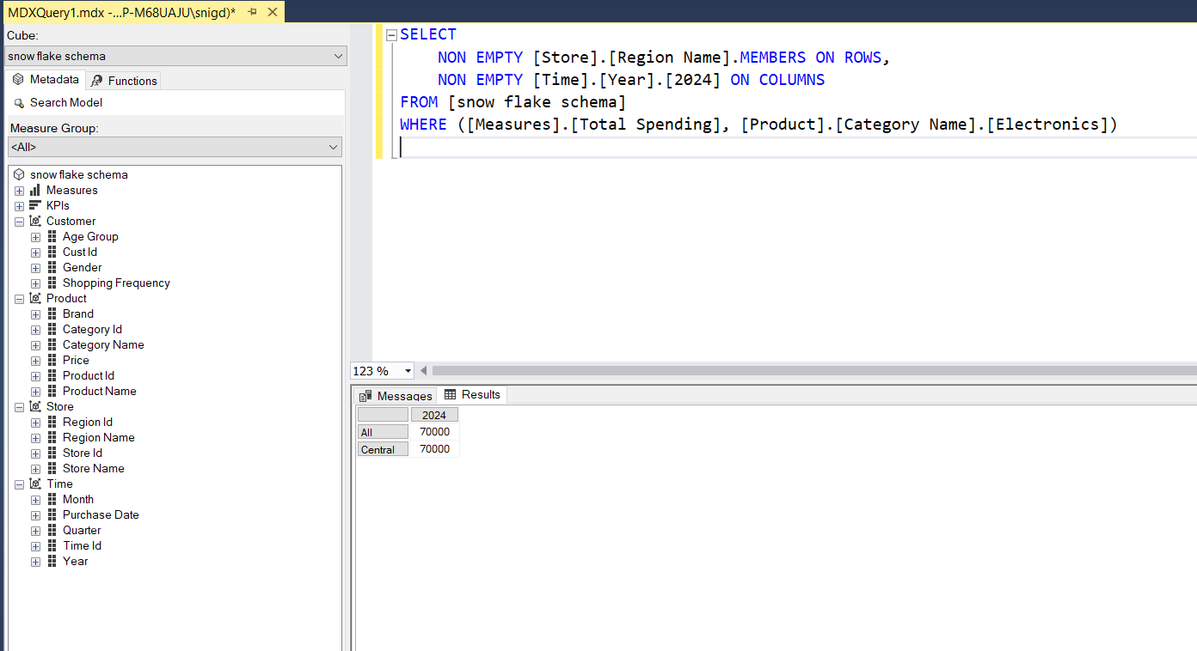
Slice: Slice for Month = ”October”
(C)What is the total spending for October?
SELECT
[Measures].[Total Spending] ON COLUMNS
FROM [snow flake schema]
WHERE ([Time].[Month].[October])
Execution Time: 1 ms
Dice:
(D) What is the total spending on electronics in 2024?
SELECT
NON EMPTY [Store].[Region Name].MEMBERS ON ROWS,
NON EMPTY [Time].[Year].[2024] ON COLUMNS
FROM [snow flake schema]
WHERE ([Measures].[Total Spending], [Product].[Category Name].[Electronics])
Execution Time: 1 ms

Slide 24
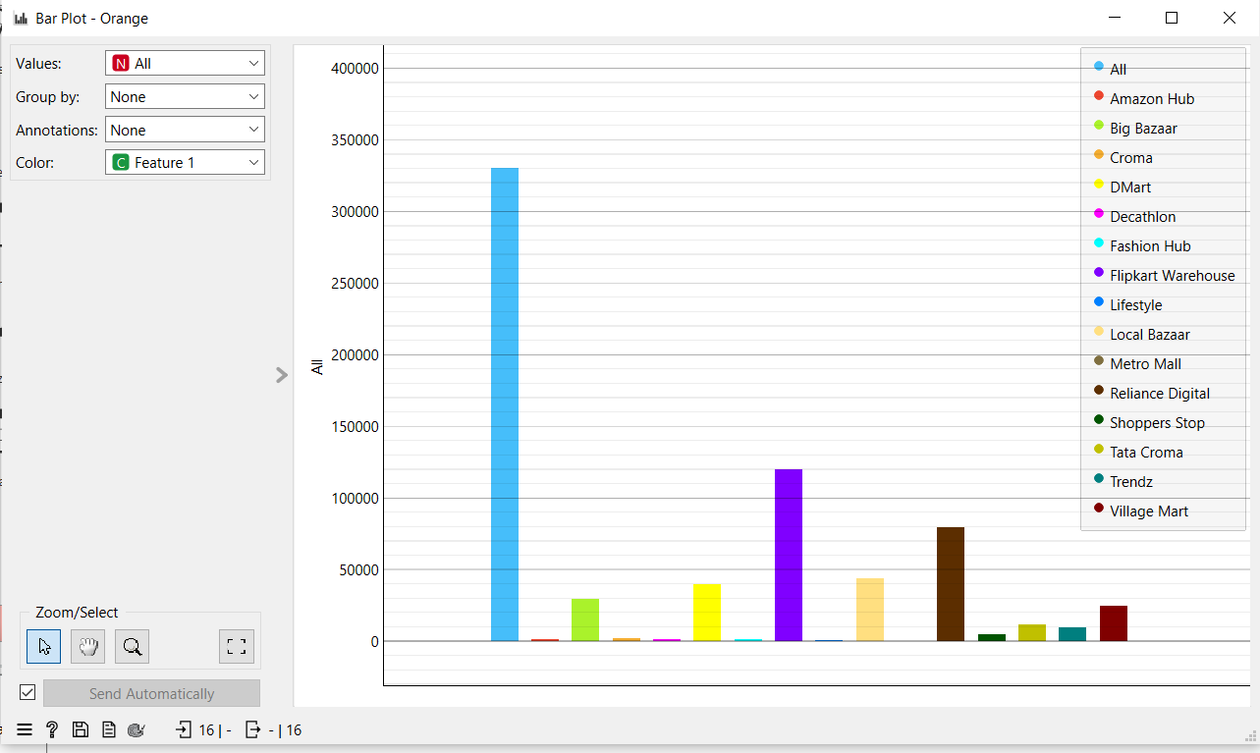
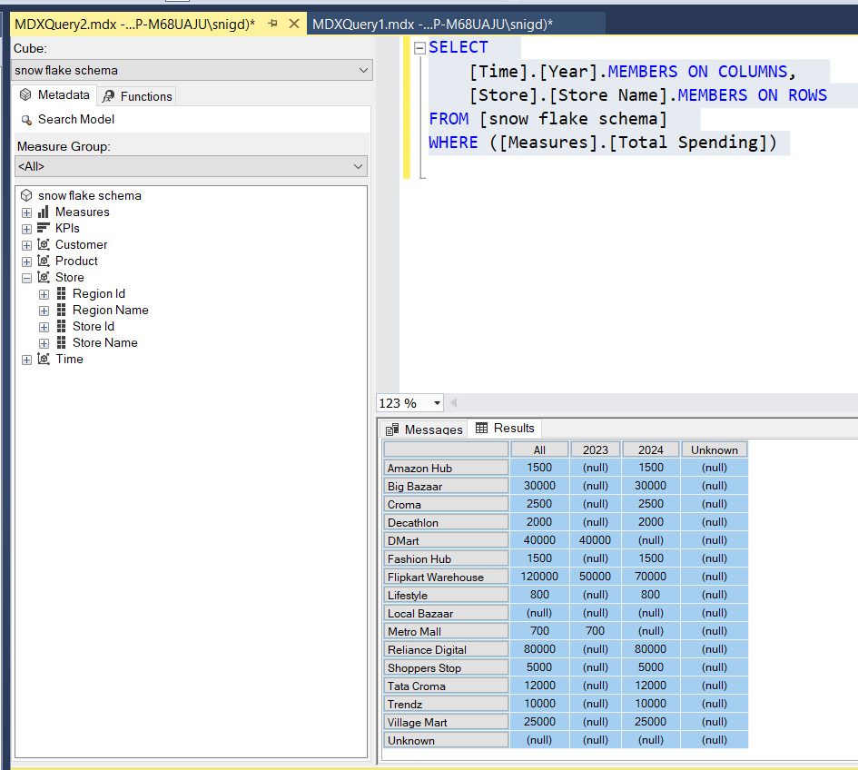
Pivot:
(E) How does total spending vary across different stores?
SELECT [Time].[Year].MEMBERS ON COLUMNS,
[Store].[Store Name].MEMBERS ON ROWS
FROM [snow flake schema] WHERE ([Measures].
[Total Spending])
Execution Time: 3 ms

Slide 25
FACT CONSTELLATION SCHEMA
I have created 4 dimension tables and 2 extended tables and 2 fact tables
The four dimension tables with attributes and fact table with attributes are below
Dimension tables :
1)Product – product_id , product_name , category_id , brand , price
2)Store – store_id, store_name , region_id
3)Customer – cust_id , age_group, gender , shopping_frequency
4) Time – time_id , purchase_date , month , quarter , year
Extended tables :
1)Region – region_id , region_name
2)Product_category – category_id , category_name
Fact table :
1)Salesfact – sales_id , cust_id , product_id , time_id , store_id , total_spending
2)Orderfact – order_id , product_id , store_id , time_id , order_quantity , order_cost

Slide 26
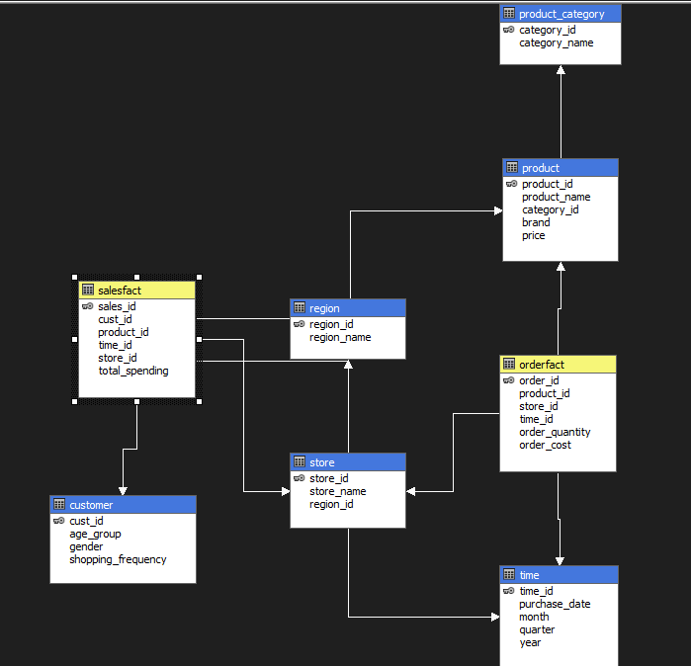
FACT CONSTELLATION SCHEMA

Slide 27
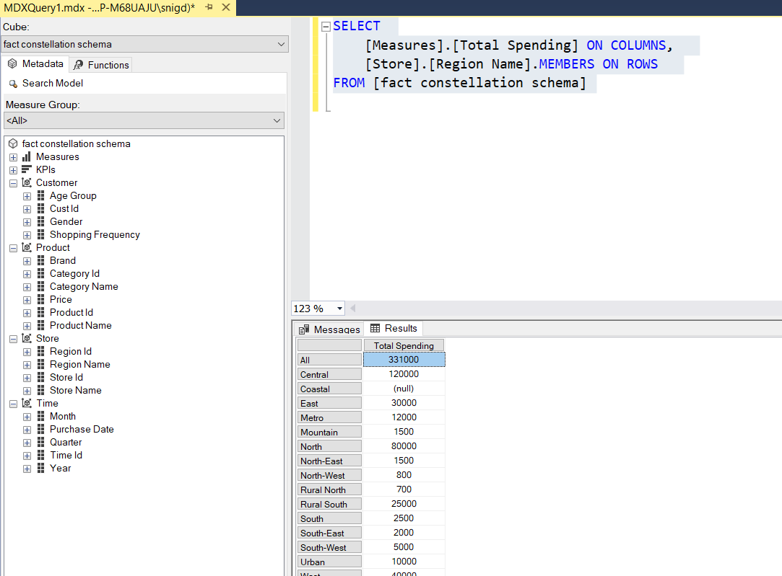
FACT CONSTELLATION-OLAP OPERATIONS
Roll-up:
(A) What is the total spending in different regions?
SELECT
[Measures].[Total Spending] ON COLUMNS,
[Store].[Region Name].MEMBERS ON ROWS
FROM [fact constellation schema]
Execution Time: 5 ms

Slide 28
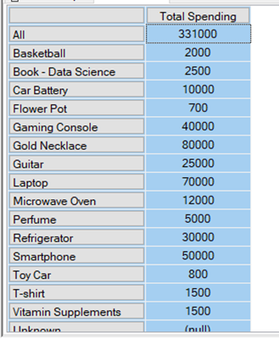
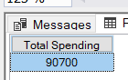
Drill Down:
(B) What is the total spending for each product?
SELECT
[Measures].[Total Spending] ON COLUMNS,
[Product].[Product Name].MEMBERS ON ROWS
FROM [fact constellation schema]
Execution Time: 5 ms
Slice: Slice for Year = ”2023”
(C) What is the total spending for the year 2023?
SELECT
[Measures].[Total Spending] ON COLUMNS
FROM [fact constellation schema]
WHERE ([Time].[Year].[2023])
Execution Time: 1 ms

Slide 29
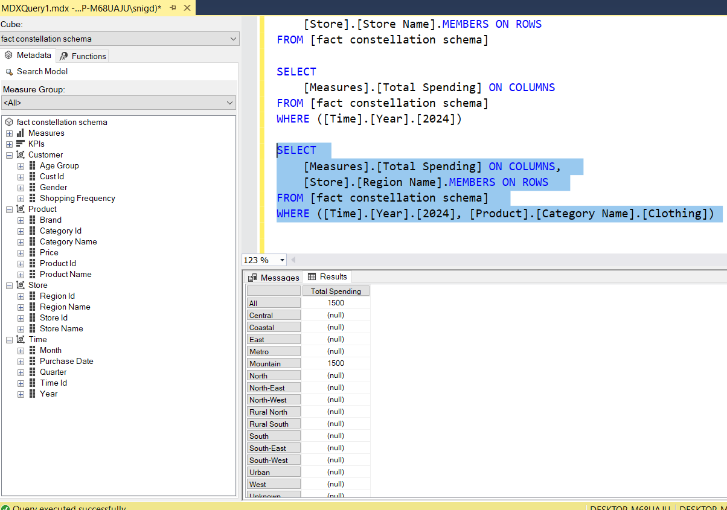
Dice:
(D) Which regions contribute to clothing spending in 2024?
SELECT
[Measures].[Total Spending] ON COLUMNS,
[Store].[Region Name].MEMBERS ON ROWS
FROM [fact constellation schema]
WHERE ([Time].[Year].[2024], [Product].[Category Name].
[Clothing])
Execution Time: 2 ms

Slide 30
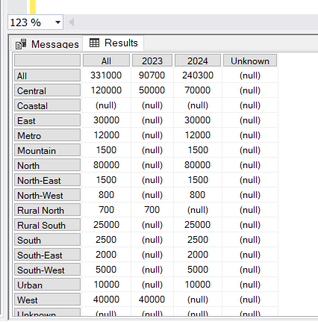
Pivot:
(E) How does total spending vary across different regions and years?
Query:
SELECT
[Time].[Year].MEMBERS ON COLUMNS,
[Store].[Region Name].MEMBERS ON ROWS
FROM [fact constellation schema]
WHERE ([Measures].[Total Spending])
Execution Time: 3 ms

Slide 31
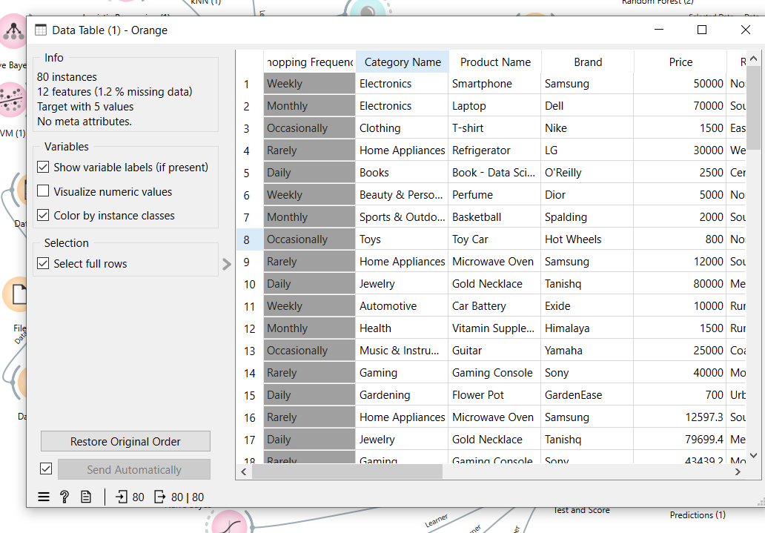
Perform Data Mining on the Dataset

Slide 32
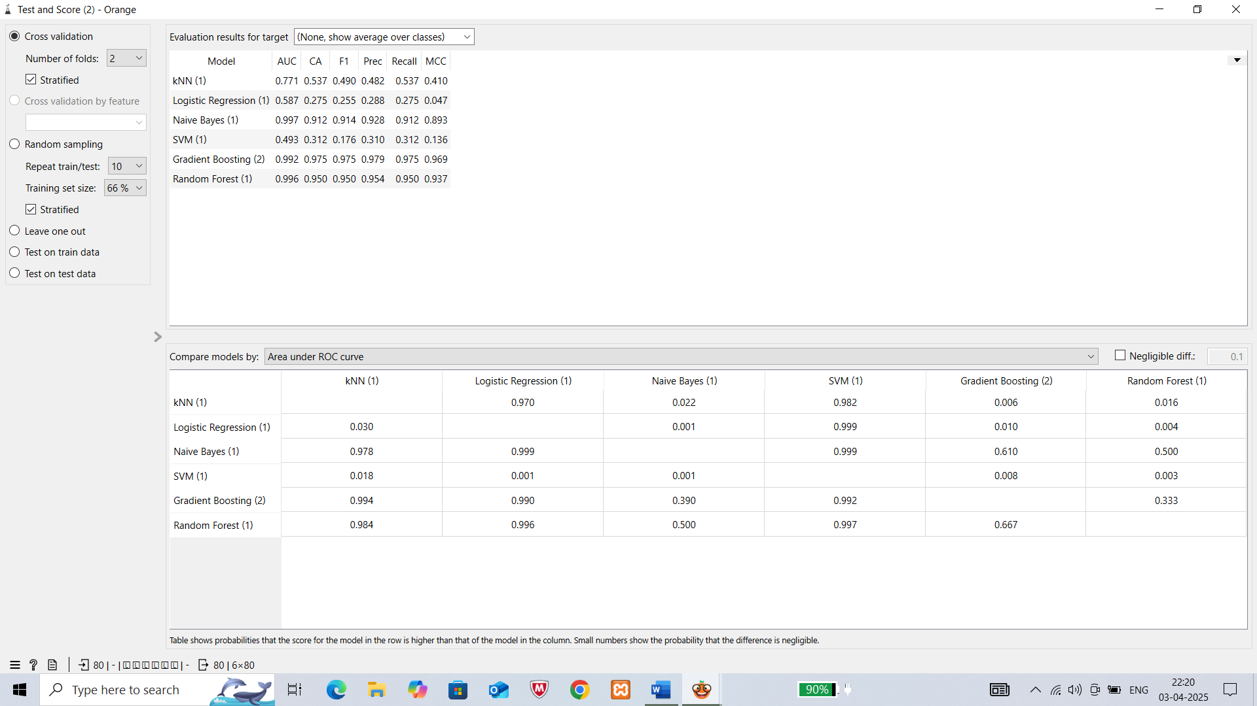
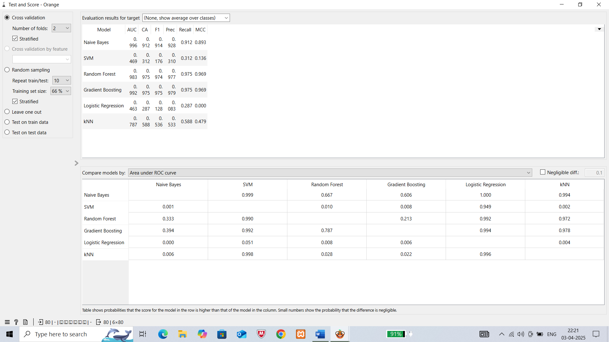
We applied normalization as preprocessing technique
To check which model is best,we use test score to decide
Without preprocessing With preprocessing
GRADIENT BOOSTING

Slide 33
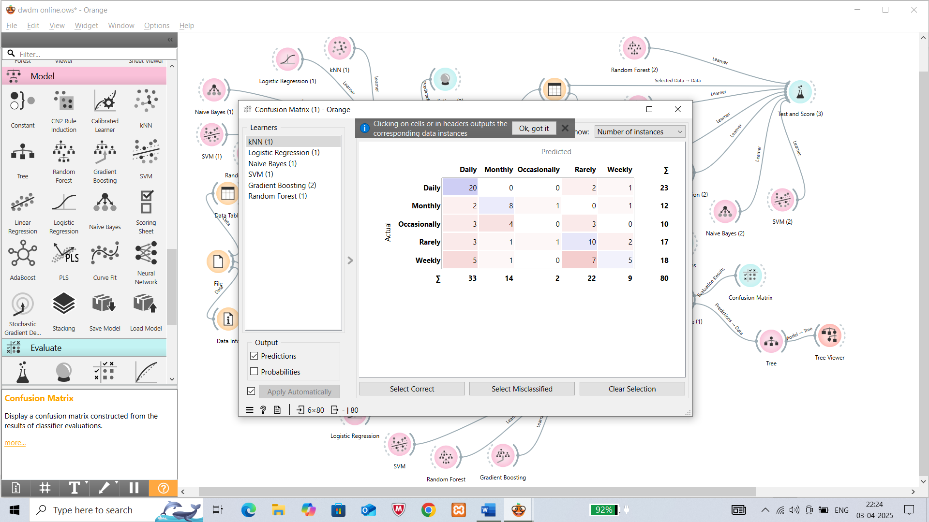
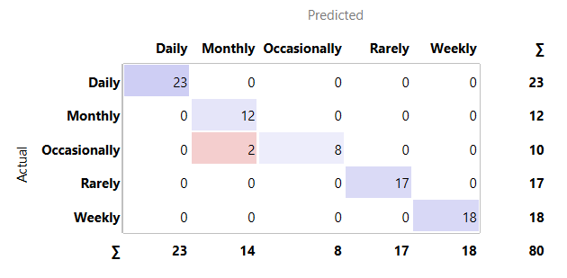
EVALUATION METRICS ….
Confusion Matrix(Without preprocessing) With preprocessing
By this we can say that preprocessing is most important

Slide 34
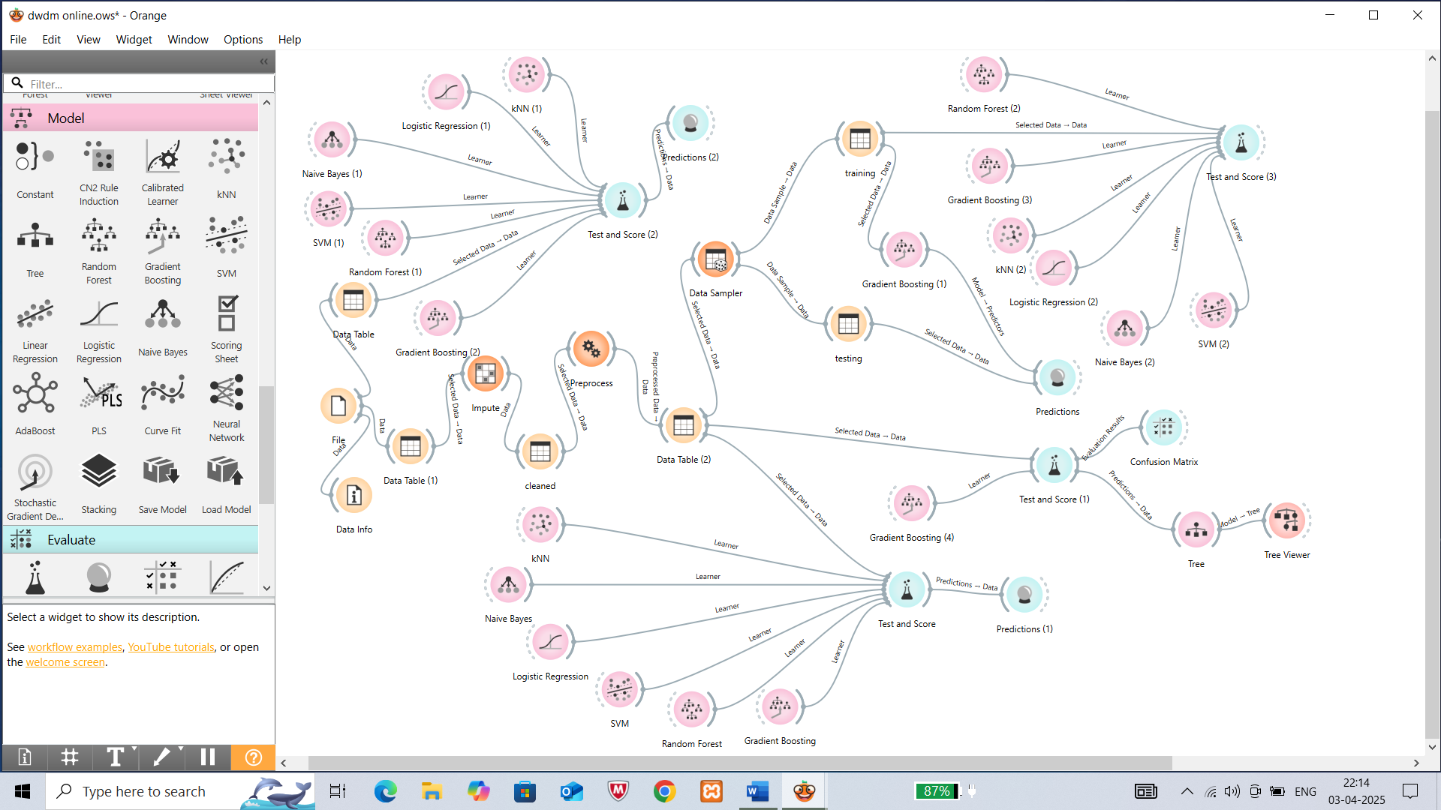
OVERALL WORKFLOW …..

Slide 35
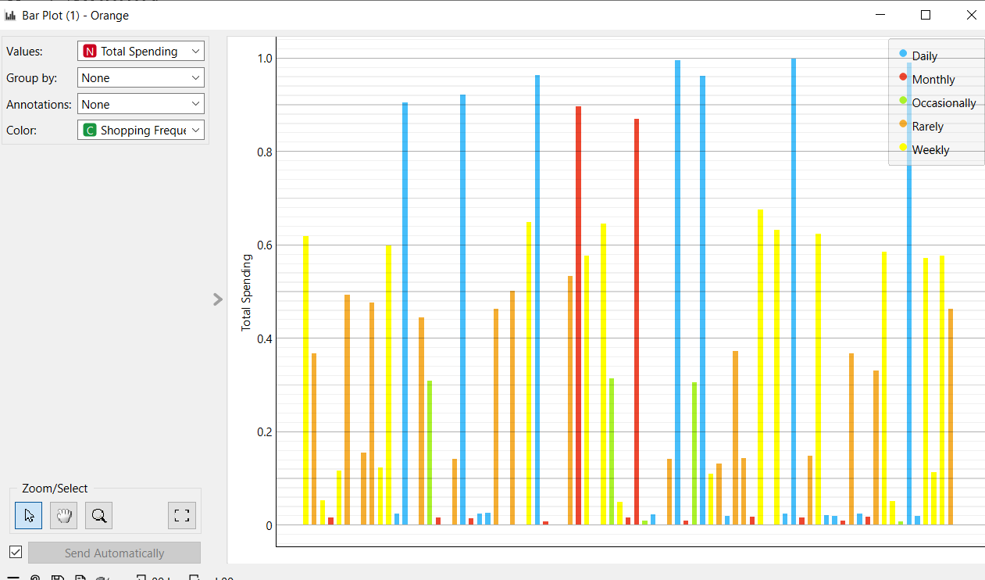
Bar plot –Analysis…..

Slide 36
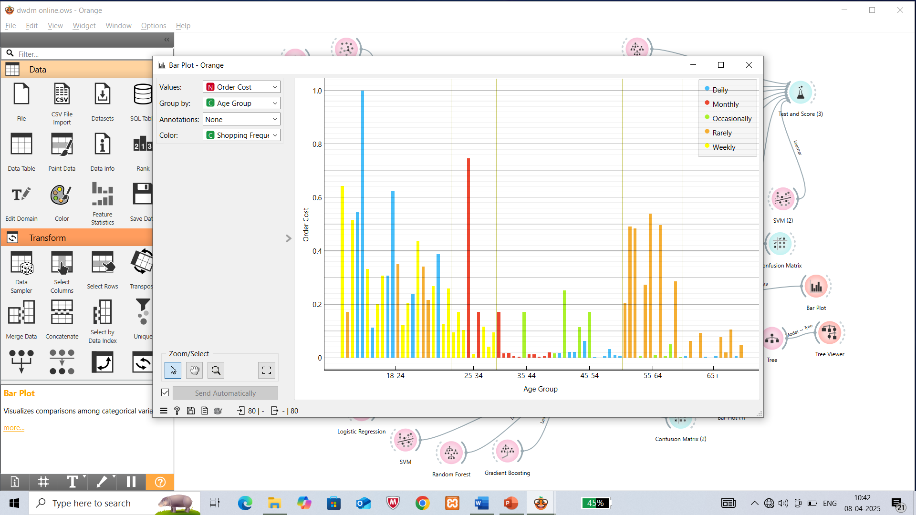
Findings

Slide 37
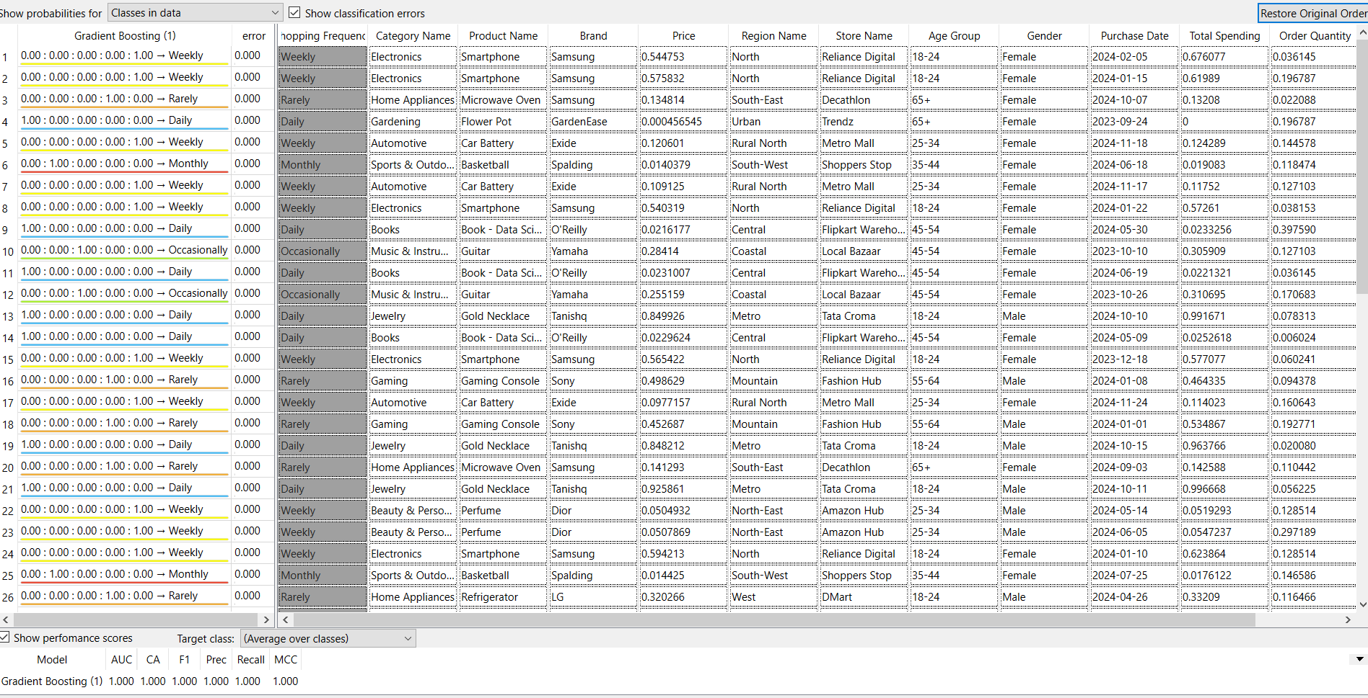
Predictions…

Slide 38
"Predictive Modeling and Regression Analysis on the Servo Dataset Using Orange”
PART-B

Slide 39
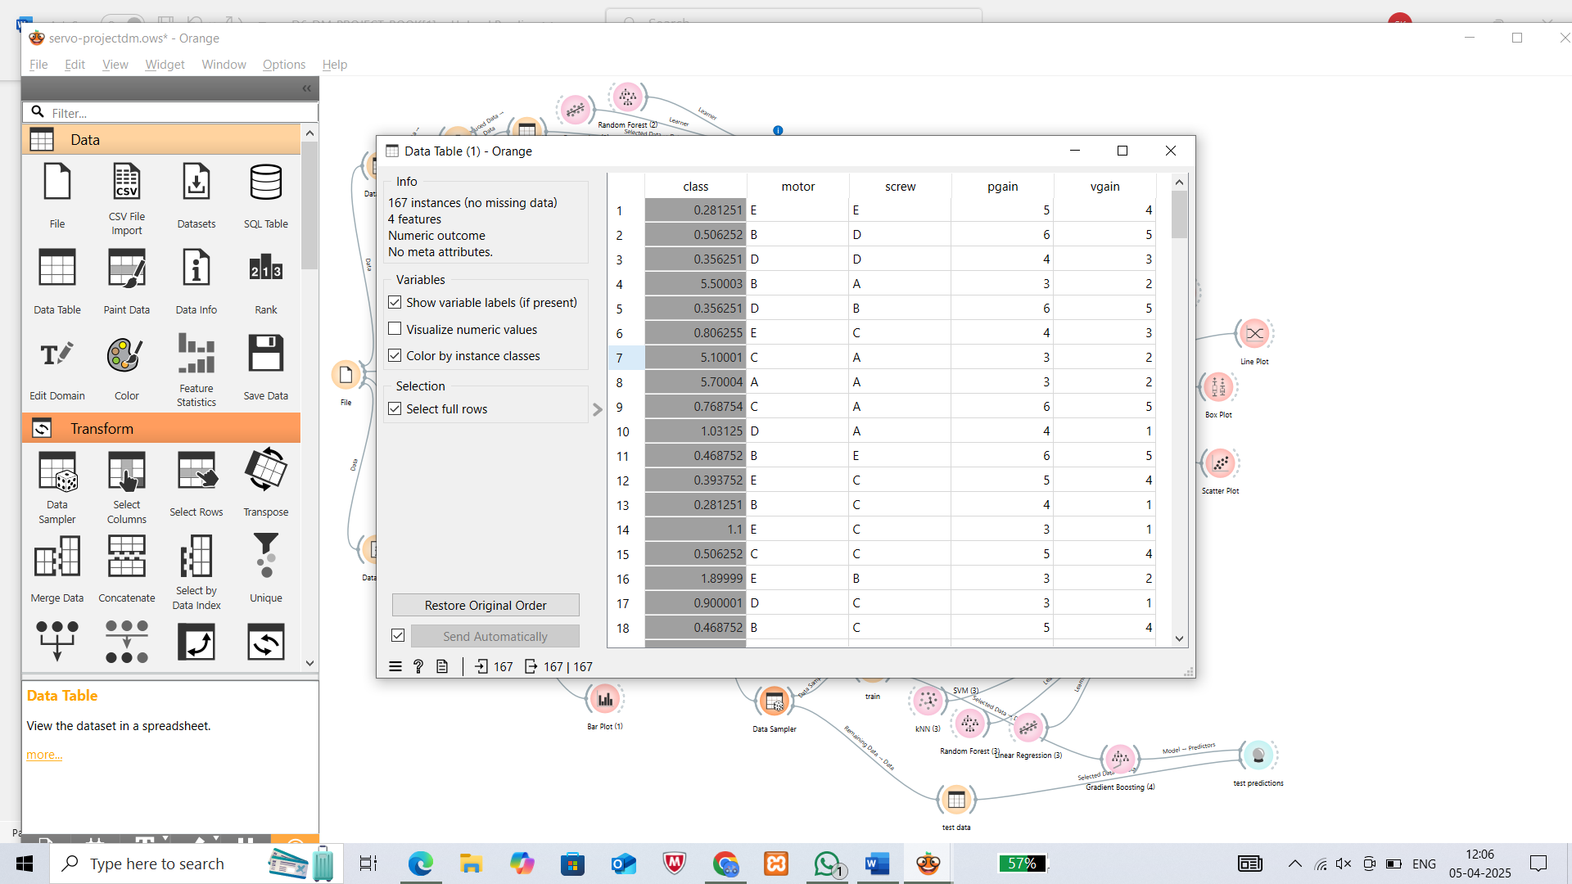
Dataset ….
The dataset contains information on servo system performance, with multiple records capturing servo motor characteristics and control settings. It includes features like motor type, screw type, proportional gain, and velocity gain, which influence the response time (target variable).

Slide 40
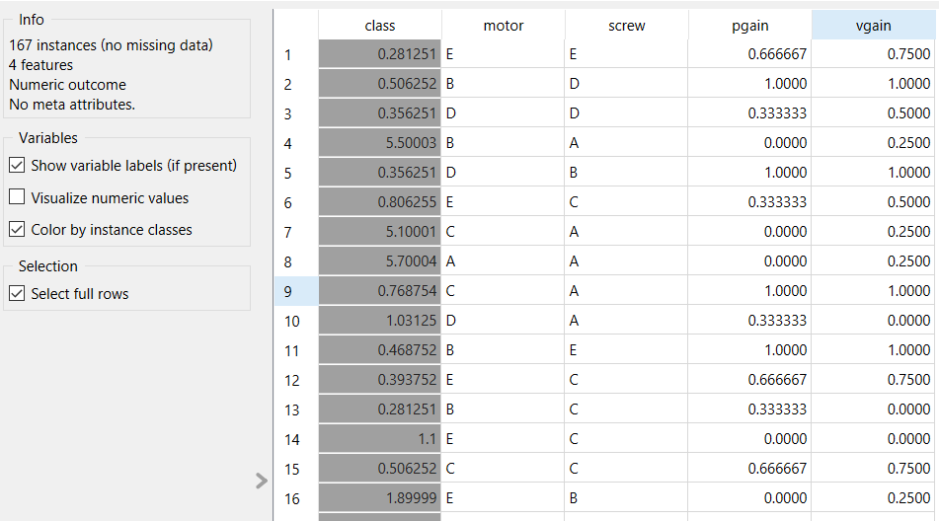
Preprocessing of Dataset….
We have 2 preproceesing techniques
Normalize features to [0,1]
Continuze –one feature per value

Slide 41
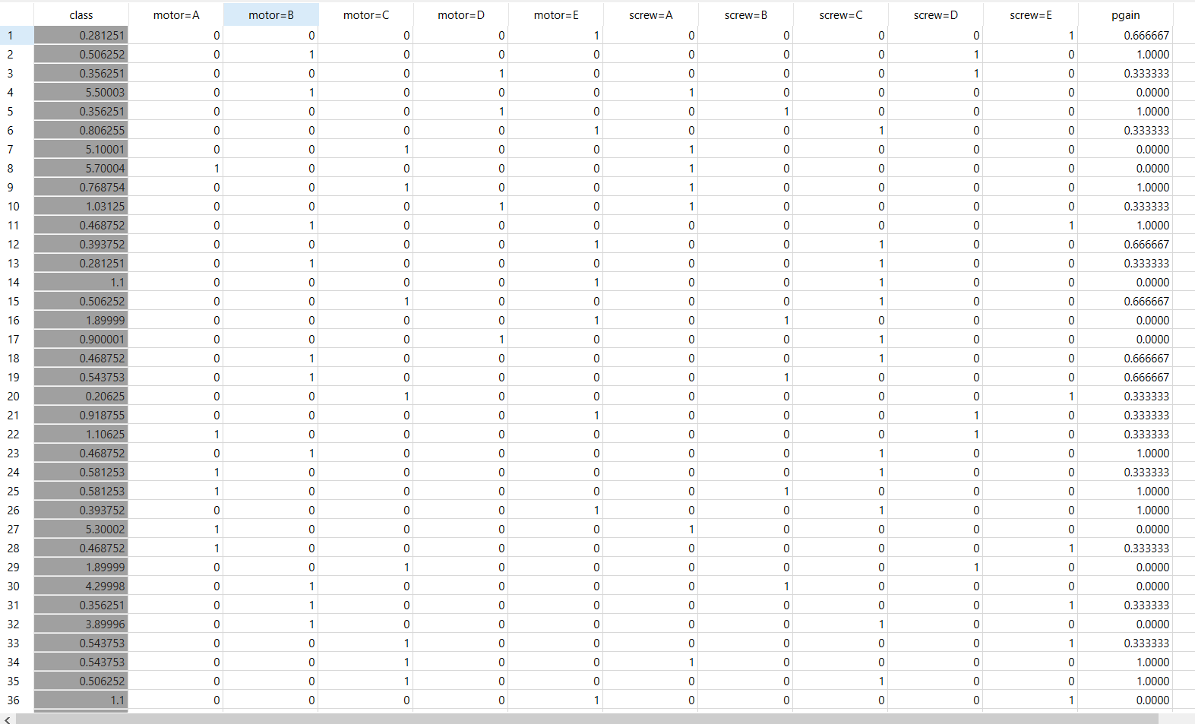
After preprocessing

Slide 42
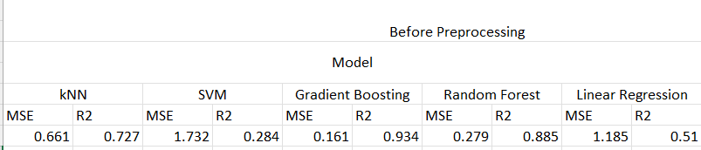
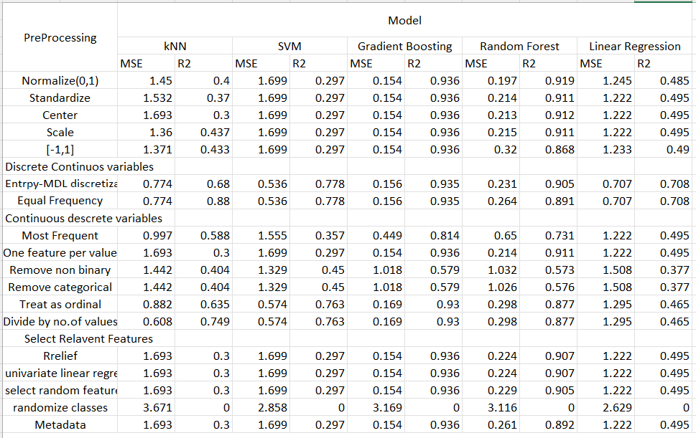

Slide 43
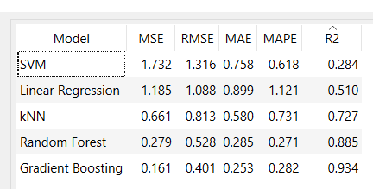
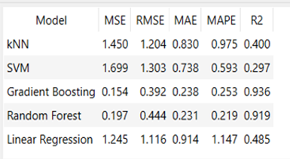
TEST AND SCORE VALUES…
After all the observations,we chosed best model-Gradient Boosting
Before Preprocessing After preprocessing
KNN: 0.400(Decreased)
Linear Regression: 0.485(Decreased)
Gradient Boosting: 0.936 (Increased)
SVM: 0.297(Increased)
Random Forest: 0.919 (Increased)

Slide 44
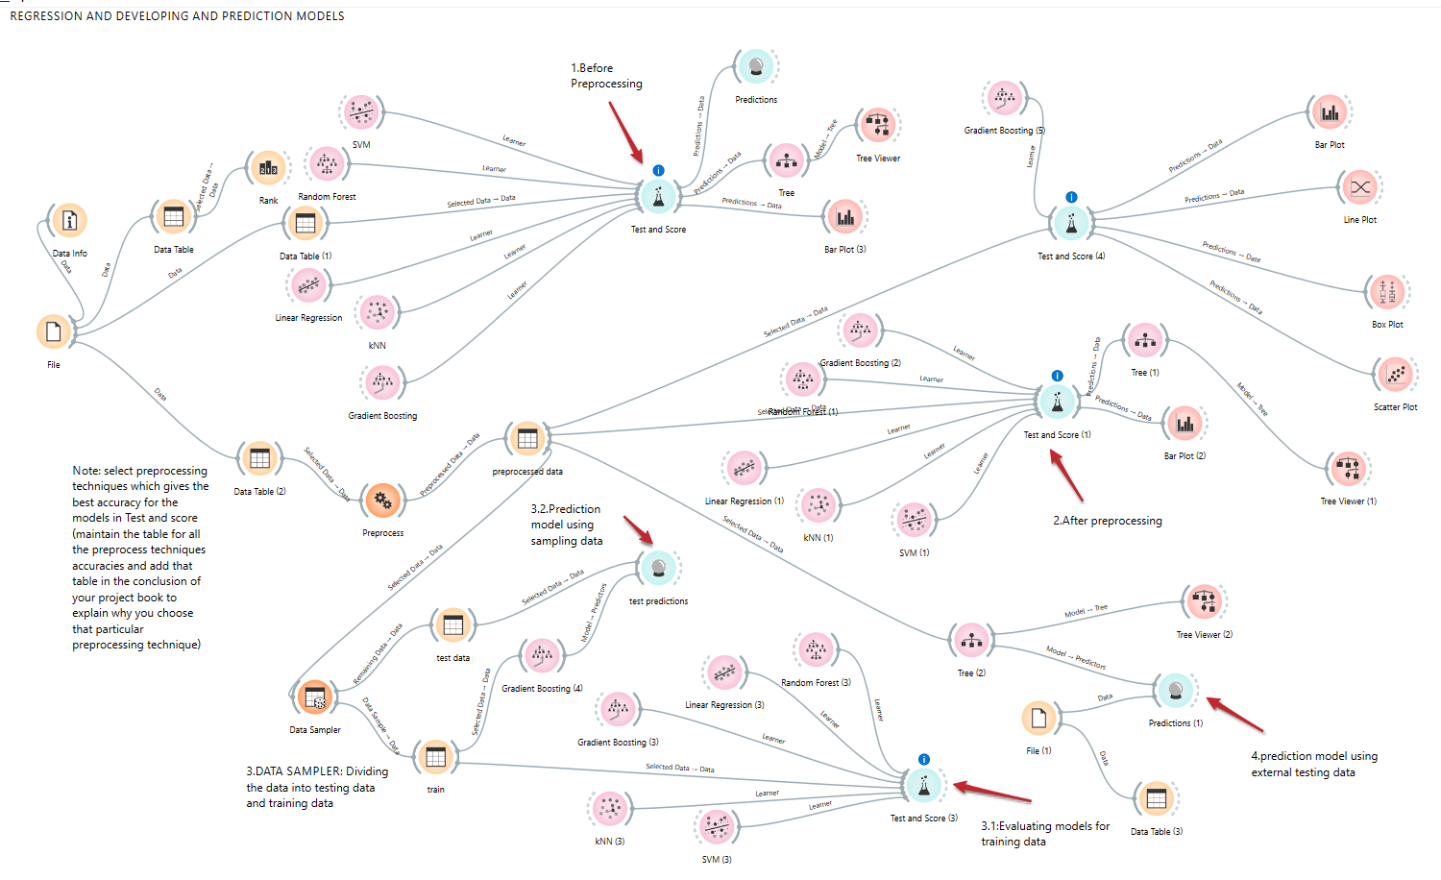
OVERALL WORKFLOW

Slide 45
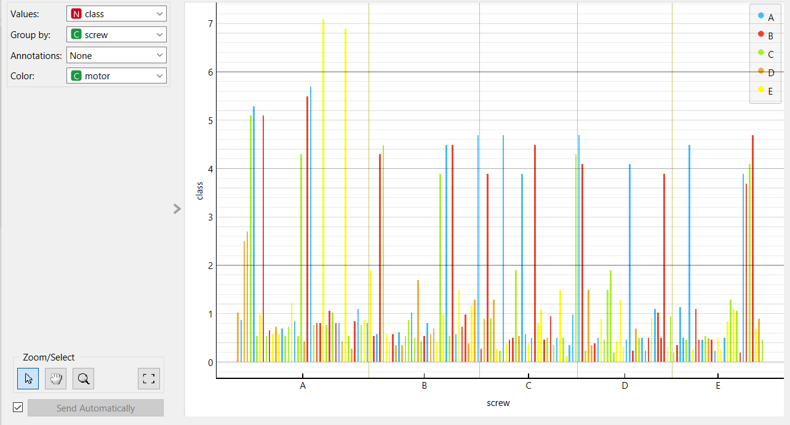
Bar plot-Analysis

Slide 46
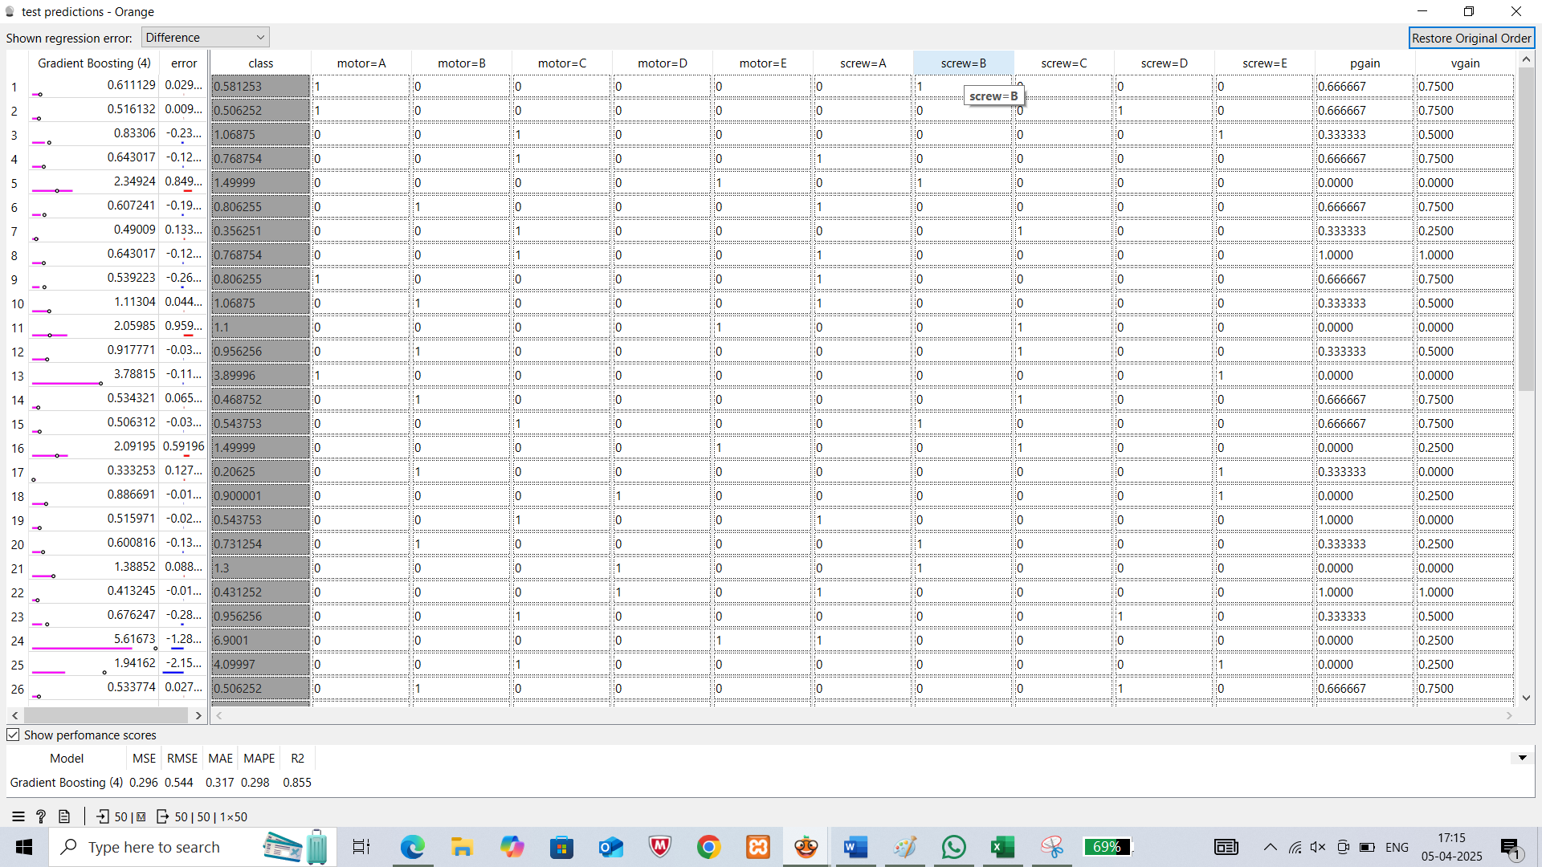
Predictions …

Slide 47


Decision tree

Slide 48
FINAL ANALYSIS
PART-C

Slide 49
Experimental Analysis
PART-A(CLASSIFICATION)
KNN,
Naïve bayes,
Gradient Boosting,
Linear Regression,
SVM,
Random Forest
. Comparison done by classification accuracy (CA), and confusion matrices
PART-B(REGRESSION)
KNN,
Logistic Regression,
Gradient Boosting,
SVM,
Random Forest
comparison done by R^2

Slide 50
Key Findings from Model Comparisons
Gradient Boosting consistently performed the best across both datasets, benefiting from its ability to classify instances effectively when properly tuned.
Support Vector Machine (SVM) - highest classification performance (AUC: 0.999)
- underperformed in regression (R²: 0.297)
Random Forest showed strong performance in regression (R²: 0.919) and competitive classification metrics, improving notably after preprocessing
K-Nearest Neighbors (KNN) performed the weakest overall
- classification (Accuracy: 58%)
- regression (R²: 0.400)

Slide 51
CONCLUSION
This study compared the experimental analysis of a classification task using the
Online Shopping dataset (Part A) and a regression task using the Servo dataset
(Part B). Key takeaways include:
Part A achieved higher accuracy faster due to well-structured data.
Part B achieved high regression accuracy, with Gradient Boosting and Random
Forest performing best due to their ability to handle structured data effectively.
Gradient Boosting emerged as the most consistent model across both tasks,
demonstrating strong generalization in both regression and classification

Slide 52


